Slide 1
LLMs
Rohit Bathula - Oliver Lane - Asa Levine - Xiuyuan Qiu

Slide 2
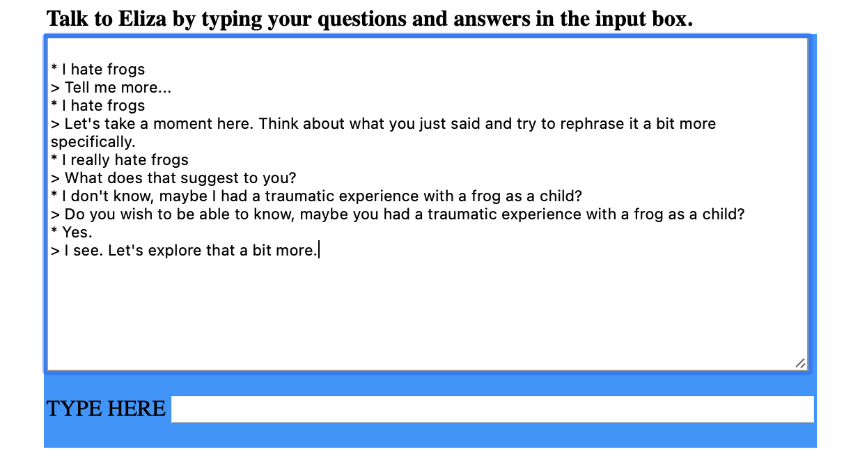
What is an LLM
-Offshoot of work in Natural Language Processing (NLP)—mix of linguistics & CS in the 60s
-Early NLP work was rules based (ELIZA demo)
Sample ELIZA conversation, generated using https://web.njit.edu/~ronkowit/eliza.html
Notes:
-Computers get stronger, so statistics/big data prediction methods start to take over > programming rules gets extremely complicated

Slide 3

What is an LLM
-Large Language Models are large statistical models built with powerful computers and massive (trillion+ word) datasets.
-It is predicting sequences of words
-”Stochastic Parrots” (Emily Bender)
-Coherent conversation:
-individuals have communicative intents
-model each other’s mental states
-LLMs cannot have coherent conversation → illusion similar to ELIZA
-Cannot reason through things

Slide 4
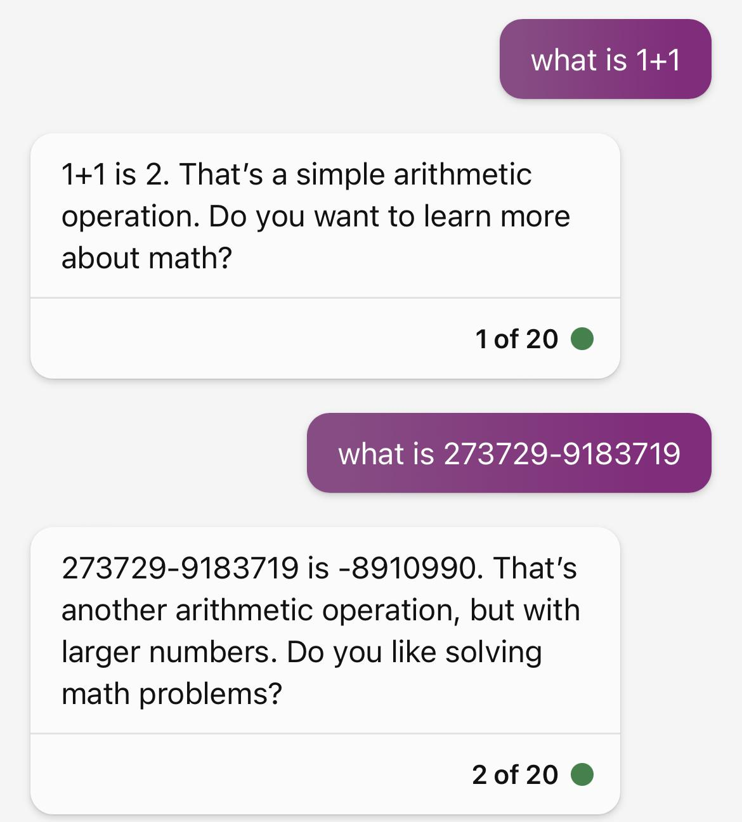
What is an LLM

Slide 5
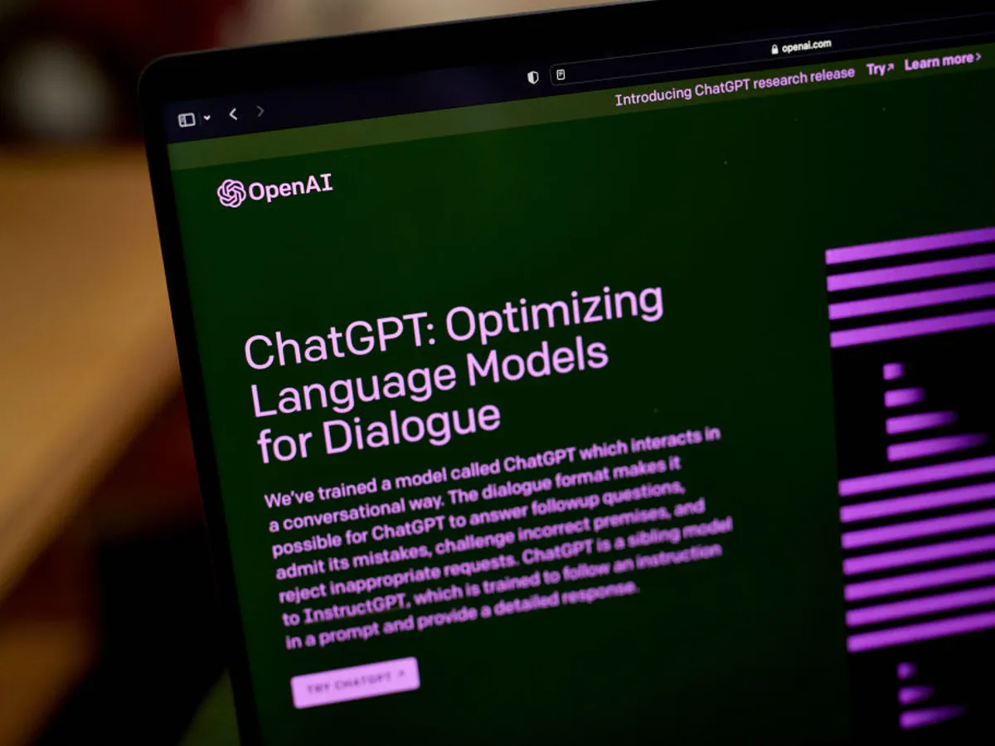
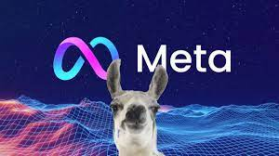

Examples of LLMs
ChatGPT by OpenAI
>100 million users
BERT by Google
SEO
LLaMA by Meta
Very new

Slide 6
LLM Data

Slide 7

Bias in data
-Bias is present in LLMs
-GPT-3 authors/Bard authors mention it in their papers
-This is because the training data is biased
-Even if developers try to mitigate bias; they introduce their own values
-Another view: people should not be treating LLMs as humanlike
-Treat them as a way to query the data their trained on
-“Blurry JPEG” (Ted Chiang)
Ted Chiang
Notes:
Better to be more accurate than less, but at a certain point, it becomes impossible to be purely true
Maybe it’s impossible with the current way of interacting in a conversation

Slide 8

Data Rights
-LLMs Memorize
-They don’t give credit
-This is bad unless there is credit
-Credit is not built into existing LLM design
-Parallels with AI art
Github copilot reciting a well known CS poem The Zen of Python
Notes:
Memorization

Slide 9
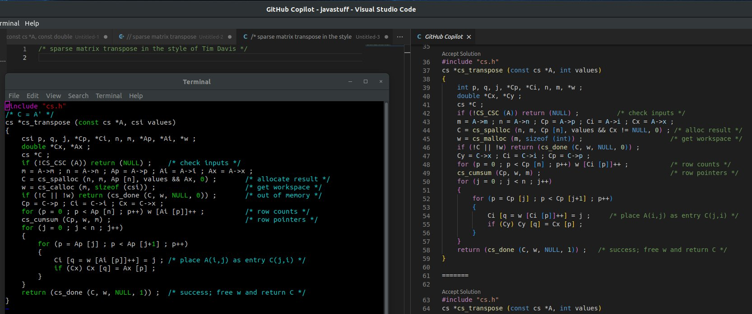
Data Rights
Tim Davis’ matrix transform algorithm appears without credit

Slide 10
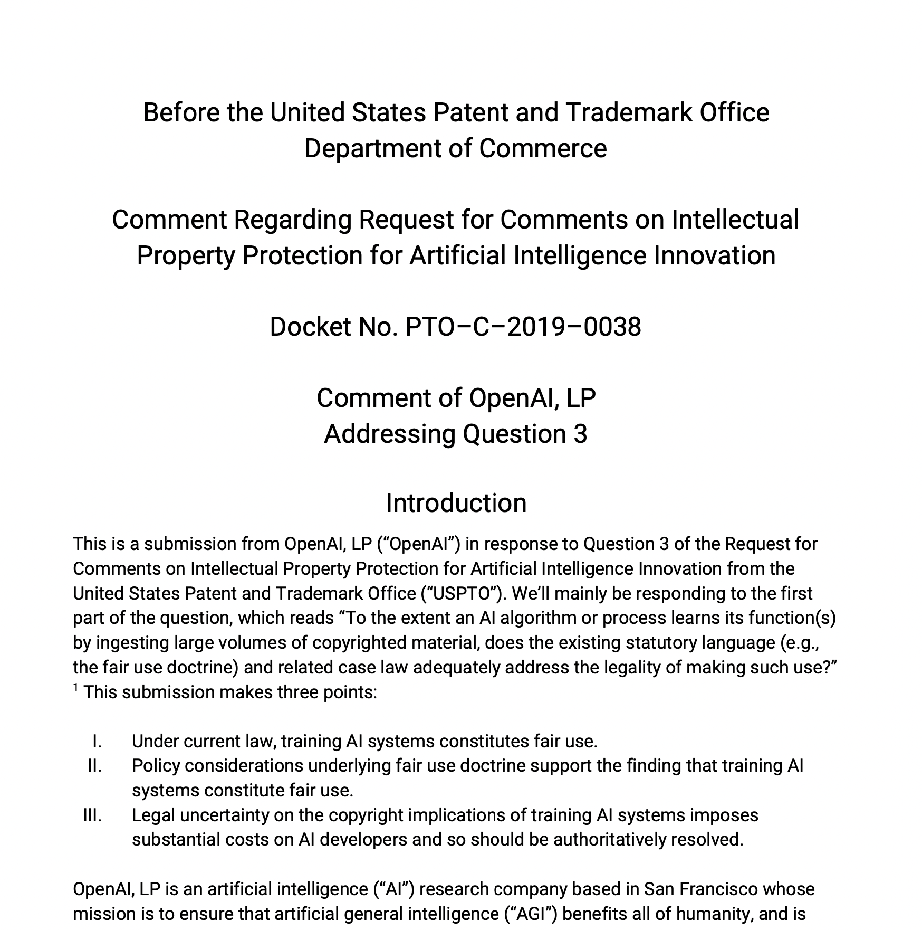
Data Rights
-Microsoft (OpenAI) argues that their use of data is transformative enough
-Search Engines can index and host copyrighted images w/o permission
-LLMs can’t regurgitate specific webpages -> more transformative than search engines
-Problem?
Notes:
thumbnails served a ‘fundamentally different use’
LLM use of data is not being read by humans so the use of copyrighted data is fundamentally different
Credit is not built in to these systems! GPT4 & Bard papers don’t actually give the source to the data; LLMs don’t have a way of checking output data for plagiarism. There needs to be a way for credit to be given.

Slide 11


LLMs in Education
Benefits
Drawbacks
Ethics

Slide 12
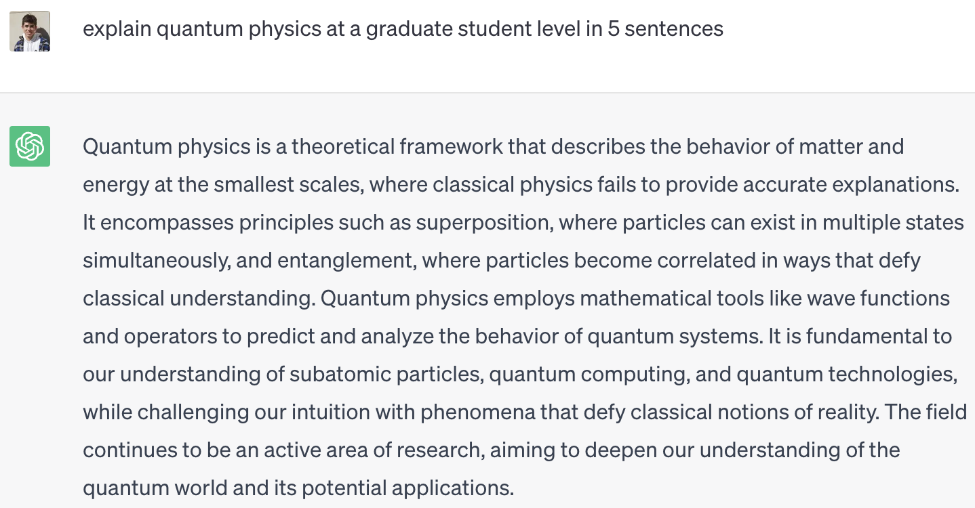
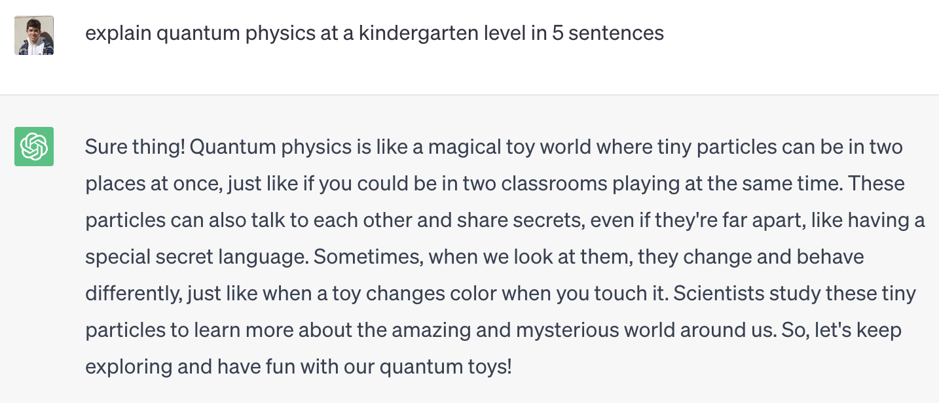
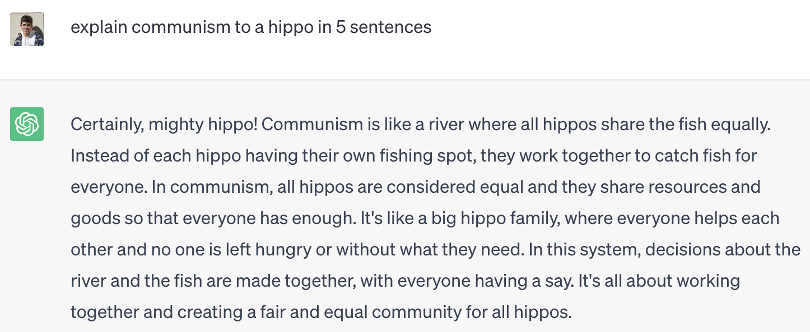
Explaining Concepts with Varying Complexity

Slide 13

Other Benefits of LLMs in Education
Summarize articles and studies
Generate practice problems with feedback
Accessible–lowers barrier to education
In the future…
Grade essays and assignments
Generate lesson plans

Slide 14

Drawbacks of LLMs in Education
Cheating
Inaccurate or toxic responses
Degrades critical thinking skills

Slide 15
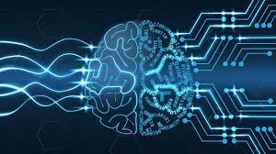
Ethical to Use? Yes
Utilitarian approach – LLMs increase total learning
Implement with caution
Teach how to use
More critical thinking in classroom
Push for open source models

Slide 16
LLMs in Work

Slide 17
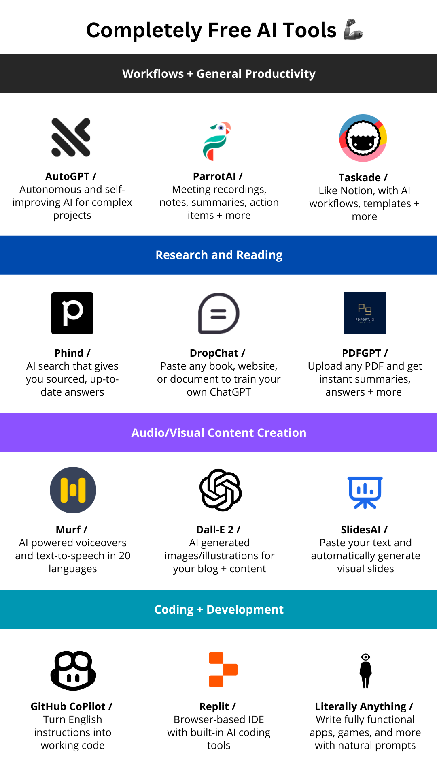
Examples of LLMs in work today

Slide 18

Benefits of LLMs in work
LLMs can directly make tasks efficient
Knowledge work is a lot more streamlined with access to tools like Microsoft copilot and Github copilot
It’s much easier to parse and analyze large datasets
LLMs can also indirectly make tasks more efficient
LLMs can act as a virtual secretary

Slide 19
Drawbacks of LLMs in work
LLMs are not trustworthy
There are many cases in which LLMs have provided wrong information or wrong answers to questions
LLMs can hallucinate
LLMs sometimes make up answers that sound correct but are not
LLMs can also draw information from sources that don’t even exist, creating false information if no information exists

Slide 20
Current LLMs are all primarily human-in-the-loop models
But what happens if LLMs can run with less or without human interaction?

Slide 21
Ethical Concerns of LLMs in work
Job displacement (risk level - high)
Thousands of people have already lost their jobs to LLMs
A team of software developers can be replaced with 1-2 developers working with LLMs
Programmers talk about how their jobs have been replaced by an AI that they helped develop!
It’s no longer enough to have a bachelor’s degree in some fields
User privacy (risk level - medium)
LLMs contain large amounts of data in order to be trained
Some of this data can be private information (Ex. Medical field)

Slide 22
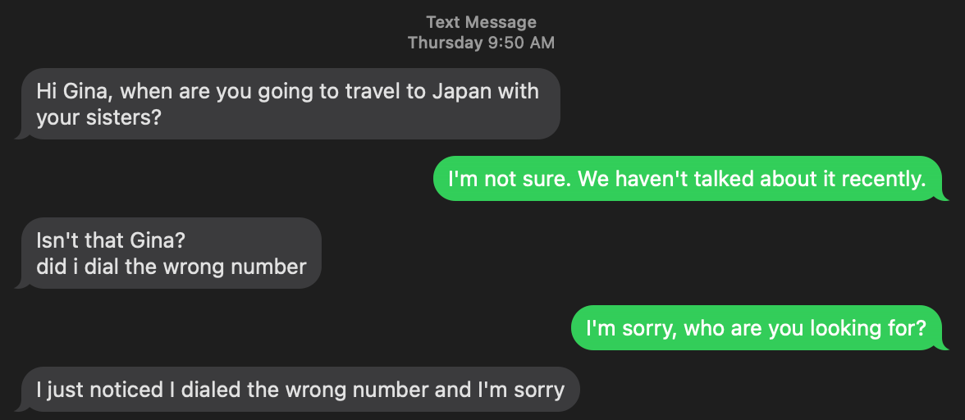
Ethical Concerns cont.
Accountability and harm
What happens if an LLM is used to produce harmful content, or leads someone to perform harmful actions? Who is accountable?
If jobs are displaced, people may use LLMs to produce ingenuine work in order to quickly find a new job
People may also use LLMs with harmful intentions to scam or produce fake news
This is already an issue without LLMs, but LLMs can make the issue more pervasive

Slide 23
Ethics of LLMs in work- Analysis
LLMs pose a high risk to the industry, and should be regulated by the corporations creating the language models such that they aren’t used for harm or ingenuine work.
Should serve as a tool or assistant, but not as a replacement to any job.

Slide 24
LLMs in The Arts and Literature

Slide 25
Benefits to The Arts and Literature

Slide 26
Benefits to The Arts and Literature
The Novel
The Additive

Slide 27
Benefits to The Arts and Literature
The Novel
The Additive

Slide 28
Benefits to The Arts and Literature
The Novel
The Additive

Slide 29
Drawbacks within The Arts and Literature

Slide 30
Drawbacks within The Arts and Literature
Authorship
Accessibility

Slide 31
Drawbacks within The Arts and Literature
Authorship
Accessibility

Slide 32
Drawbacks within The Arts and Literature
Authorship
Accessibility

Slide 33
Recommendation
“Hesitant Hopefulness”

Slide 34
Thank you!
Questions, Comments, or Concerns?

